Slide 1
Practical Methods to Maximize Thiols
Nick Harris
Co-Founder
Berkeley Yeast

Slide 2
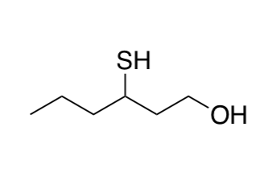
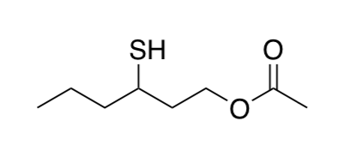
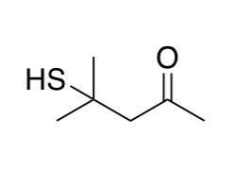
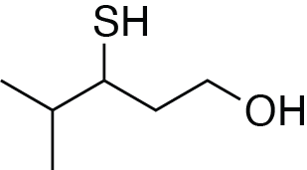
Most commonly discussed thiols in beer
3MH
Passionfruit, Grapefruit
60 ng/L
3MHA
Passionfruit, Guava
4 ng/L
4MMP
Boxtree, Black Currant
4 ng/L
3S4MP
Passionfruit, Tropical
70 ng/L
These two thiols will be the primary focus to today’s talk

Slide 3
Quick refresher on units
1 Liter of Beer
ppm: parts per million
1 ppm = (1 x 10⁻⁶) or 0.0001%
mg/L , mg/kg , μg/mL , μg/g
ppb: parts per billion
1 ppb = (1 x 10⁻⁹) or 0.0000001%
μg/L , μg/kg , ng/mL , ng/g
ppt: parts per trillion
1 ppt = (1 x 10⁻¹²) or 0.0000000001%
ng/L , ng/kg , pg/mL , pg/g
50 g/L Ethanol
15 mg/L Ethyl Hexanoate
100 μg/L Diacetyl
500 ng/L 3MH

Slide 4
A Tropical Journey: Precursors to Free Thiols

Slide 5
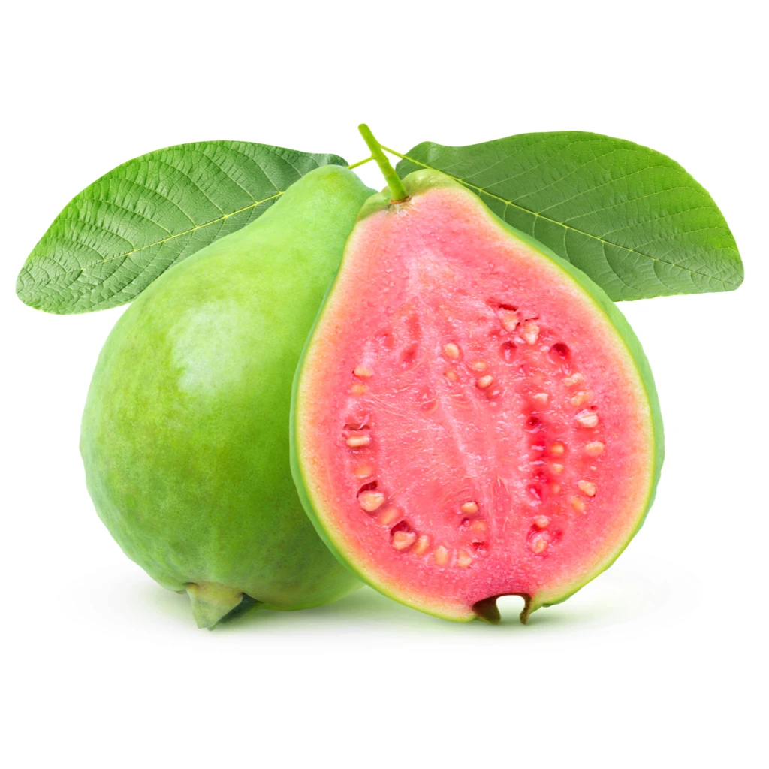
Yeast is a thiol biofactory
Yeast Cell
Transporter
ADH
GST
Peptidase
C-S lyase
Peptidase

Slide 6
How to increase the concentration of thiols in finished beer
Primary Strategies:
Add free thiols to beer (eg. dry hop)
Use yeast with high biotransformative activity
Add thiol precursors and convert them (biotransformation)

Slide 7
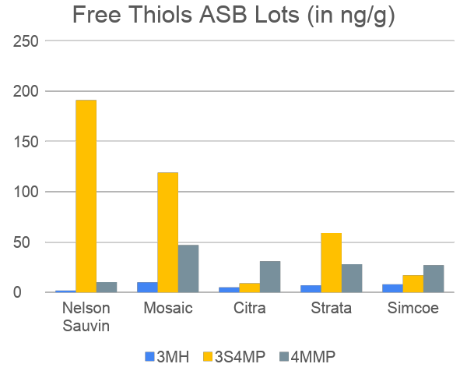
Strategy 1: Add free thiols to beer
Free Thiols (ng/g)
Request concentrations of free thiols from hops supplier or send for analysis
Every lot may be different
For dry hopping, free thiols are most important metric (not precursors)
Can calculate potential thiols in beer (assuming 100% extraction):
(ng thiols/g hops) * (g of dry hops/L of beer) =
ng thiols/L of beer
Source: Hop Quality Group

Slide 8
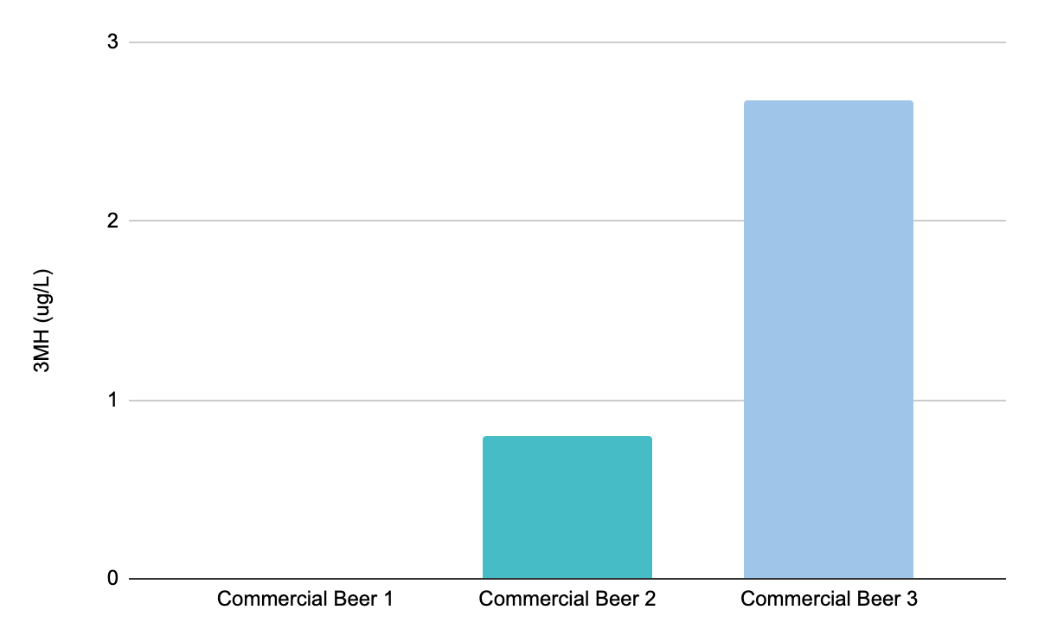
Strategy 1: Add free thiols to beer
Thiol Concentration in Packaged Beer
All beers fermented with standard (non thiol yeast)
Beer 1 is pilsner
Beer 2 and 3 both contain ~4 lbs/BBL
Beer 3 is only NZ hops
Choice of dry hop can have huge impact on thiol concentration

Slide 9
Strategy 2: Use biotransformative yeast

Slide 10
Remember, yeast is a thiol biofactory
Yeast Cell
Transporter
ADH
GST
Peptidase
C-S lyase
Peptidase

Slide 11
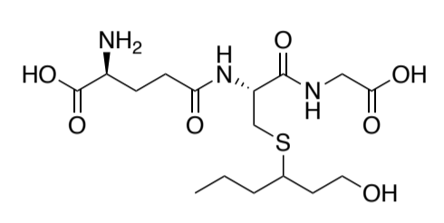
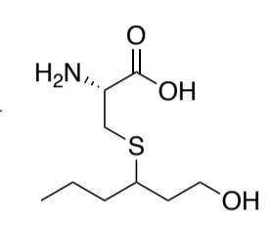
Where do thiols come from: Precursors
Barley and hops have thiol precursors
Most common 3MH precursors are: Cysteinylated and Glutathionylated thiol precursors (often written seen as Cys-3MH and Glut-3MH)
Increasing precursors → Increased thiol potential
Glut-3MH
Cys-3MH

Slide 12
Yeast can biotransform conjugated thiols into free thiols
Carbon-Sulfur Lyase (CSL)
Breaks carbon-sulfur bond to release free thiol Acyltransferase forms ester

Slide 13
Carbon-Sulfur Lyase mediates the conversion of bound thiol to free thiol
Carbon-Sulfur Lyase (CSL)
-Describes the breaking of a carbon-sulfur bond
Cysteine-S-Conjugate β-Lyase
-Describes beta elimination of the substrate cysteine
CSL
Cysteine-Conjugate
Water
Pyruvate
Ammonium
Thiol

Slide 14
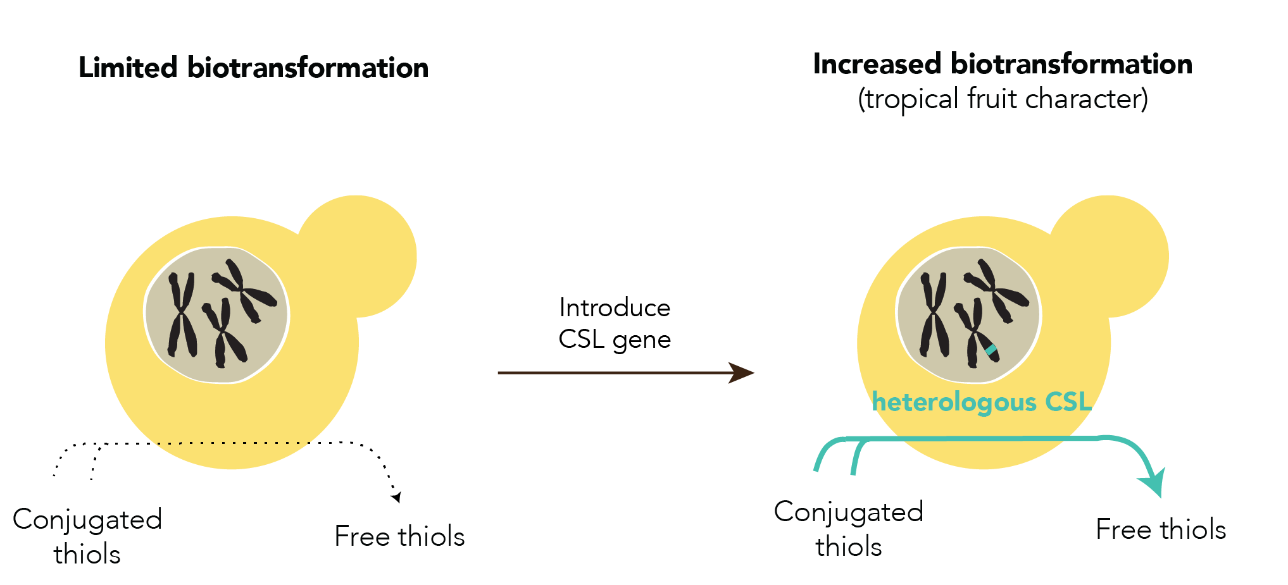
Inserting an active CSL increases biotransformation

Slide 15
Scientific Intermission: a quick lesson about genes and gene expression

Slide 16
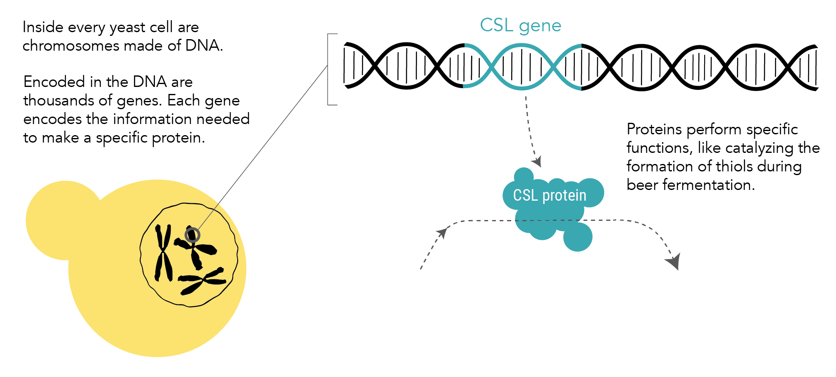

Slide 17
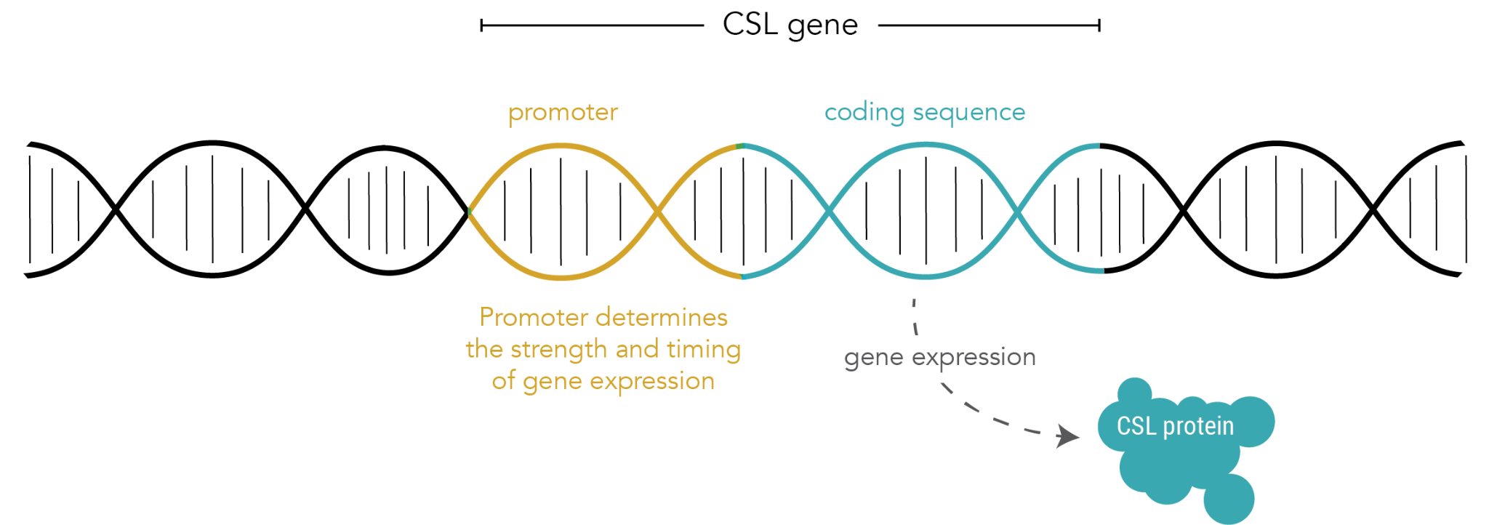
Promoters are DNA elements that determine how much of an enzyme a cell will produce

Slide 18
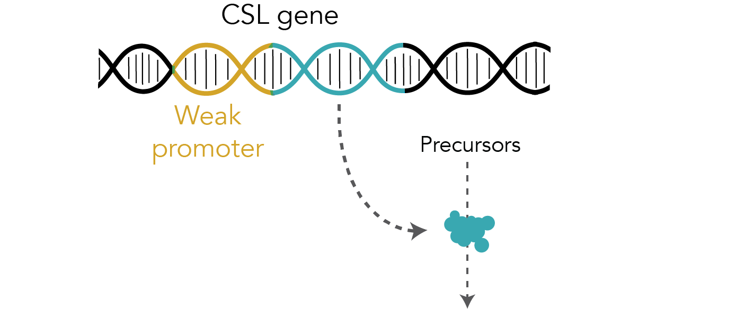
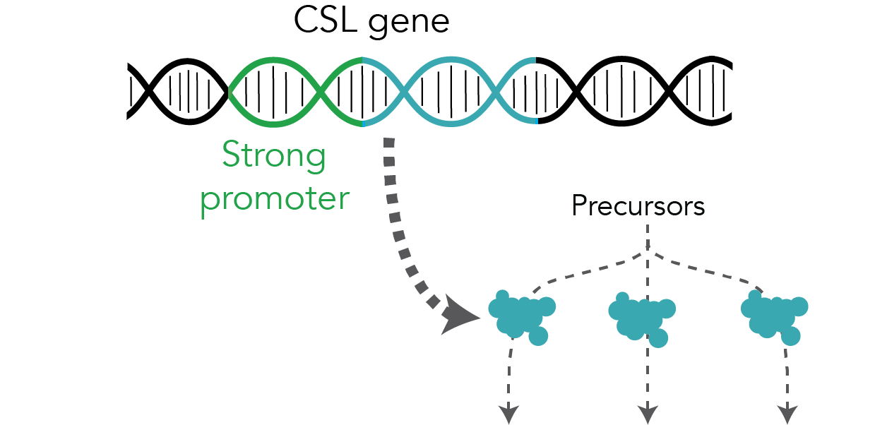
Gene promoters can impact beer flavor

Slide 19
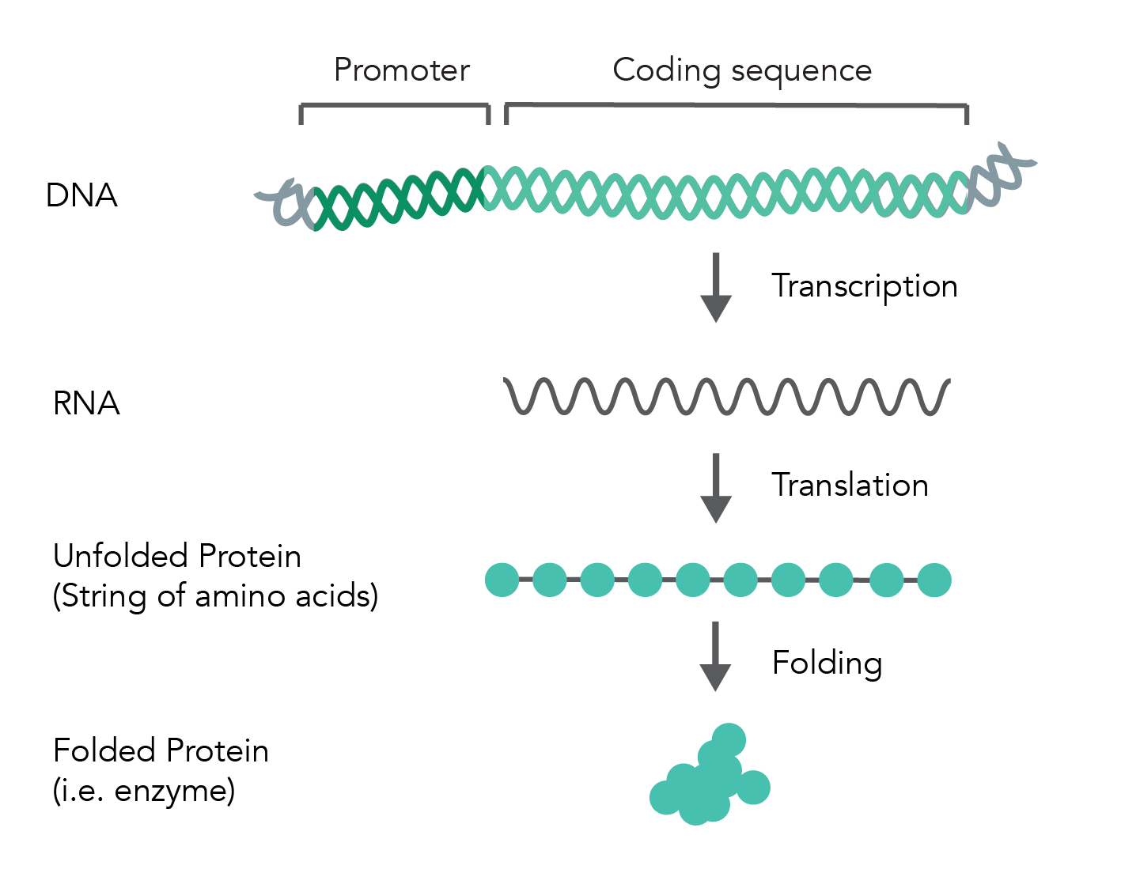
Central Dogma of Molecular Biology

Slide 20
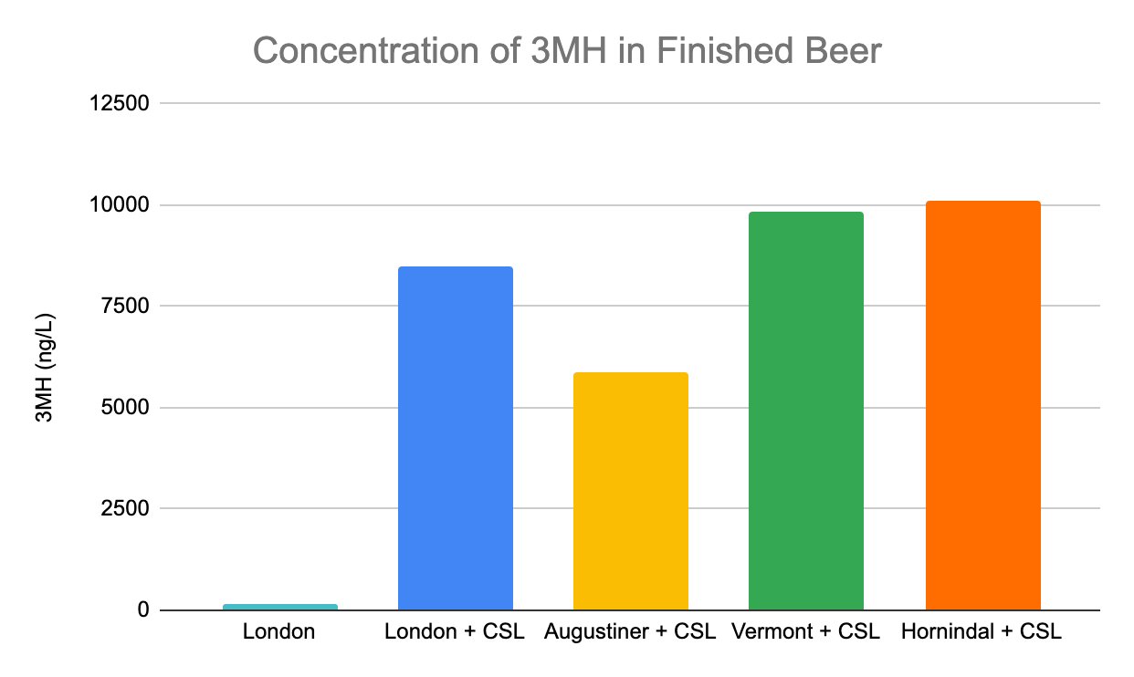
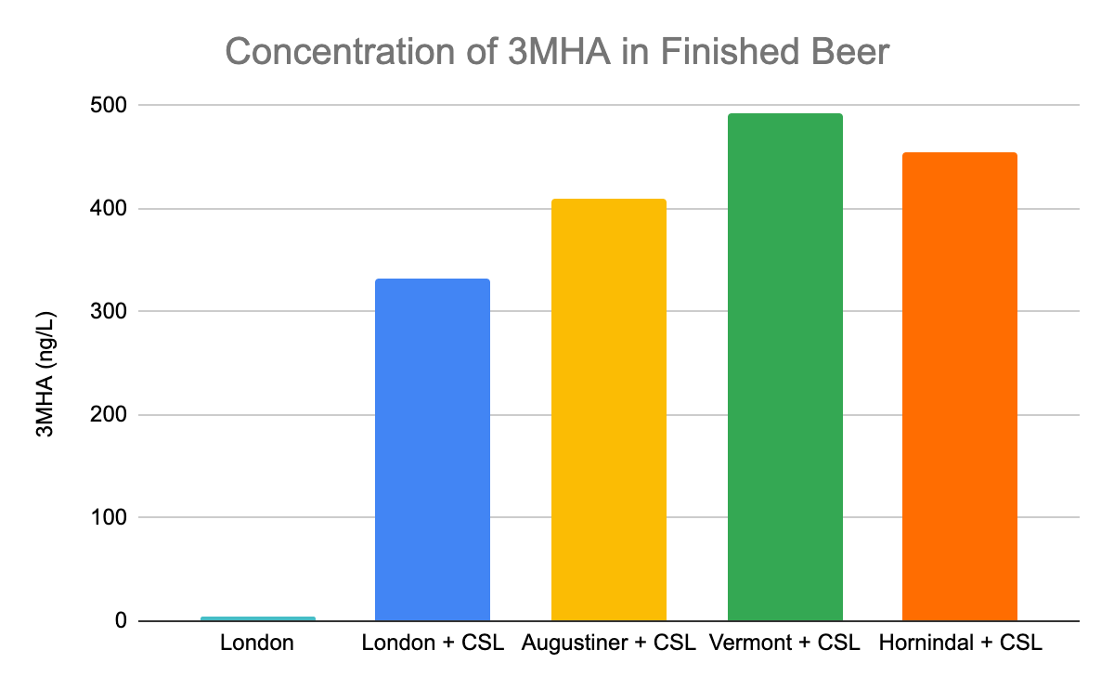
3MH production varies between engineered strains expressing CSL

Slide 21
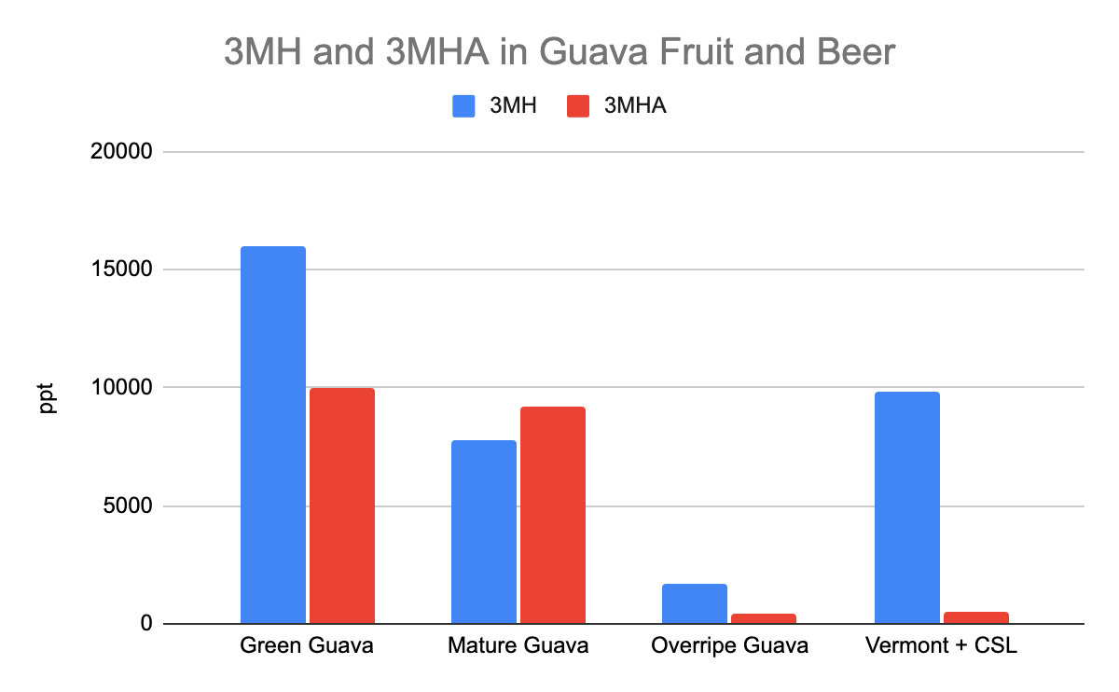
Comparison 3MH and 3MHA Concentrations in Guava Fruit and Beer
Guava data from: Cannon and Ho, J Food Drug Anal, 2018

Slide 22
Strategy 3: Increase thiol precursors to increase biotransformative potential

Slide 23
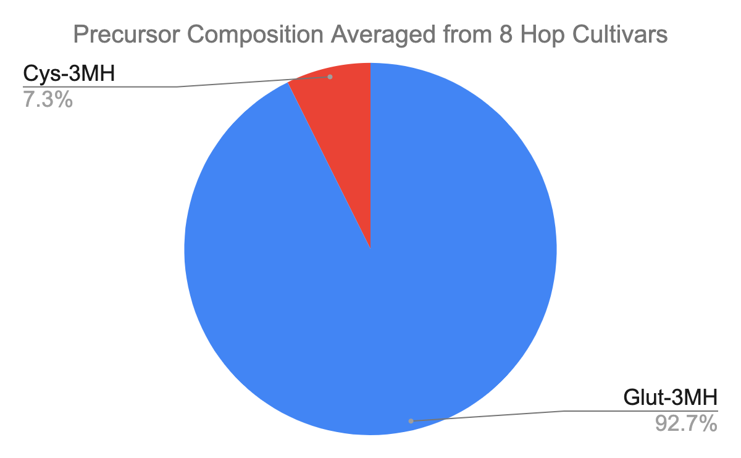
Precursor ratios
Glut-3MH is typically more abundant than Cys-3MH in both barley and hops
Adapted from: Roland et al, Flavour Fragr J., 2016

Slide 24
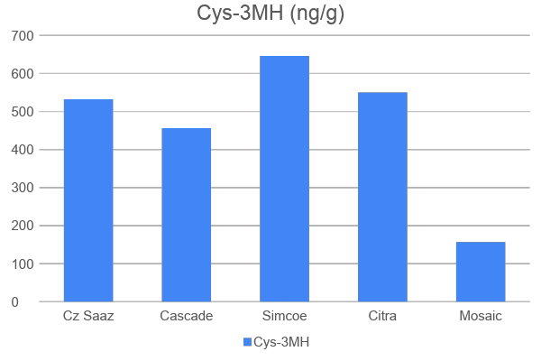
Hops have varying levels of precursors
Source: Roland et.al., BarthHaas / Dagan

Slide 25
Mash hopping
Mash hopping
Idea is to convert Glut-3MH to Cys-3MH
Mash conditions may convert some of the Glut to Cys
Transporter
ADH
GST
Peptidase
C-S lyase
Peptidase

Slide 26
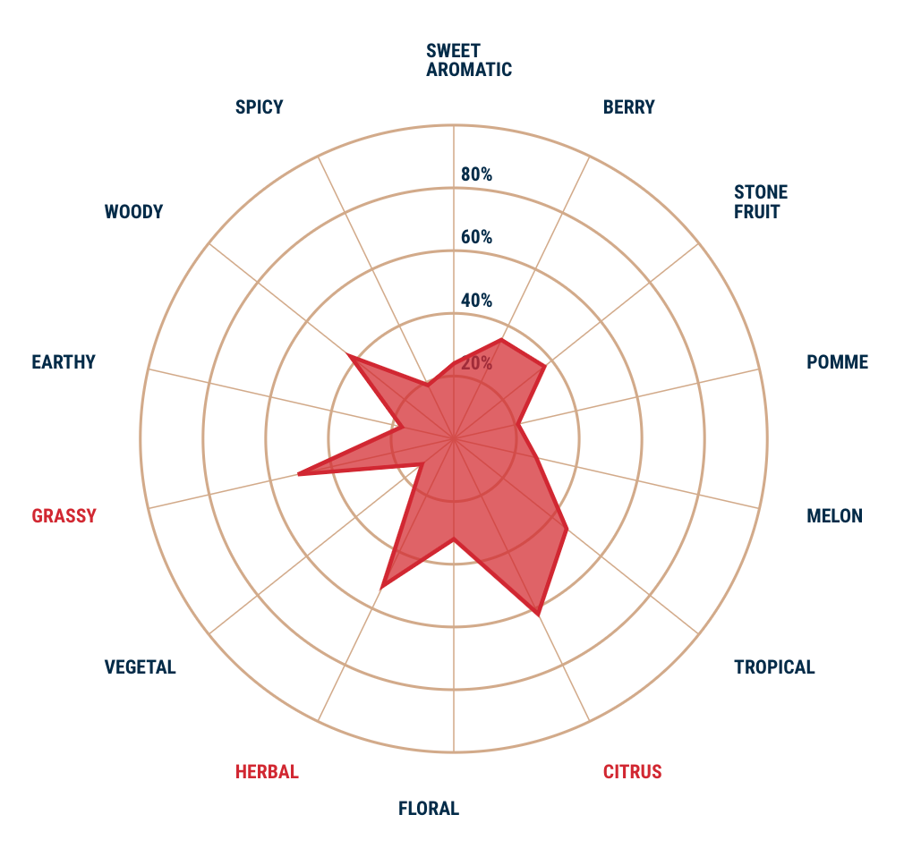
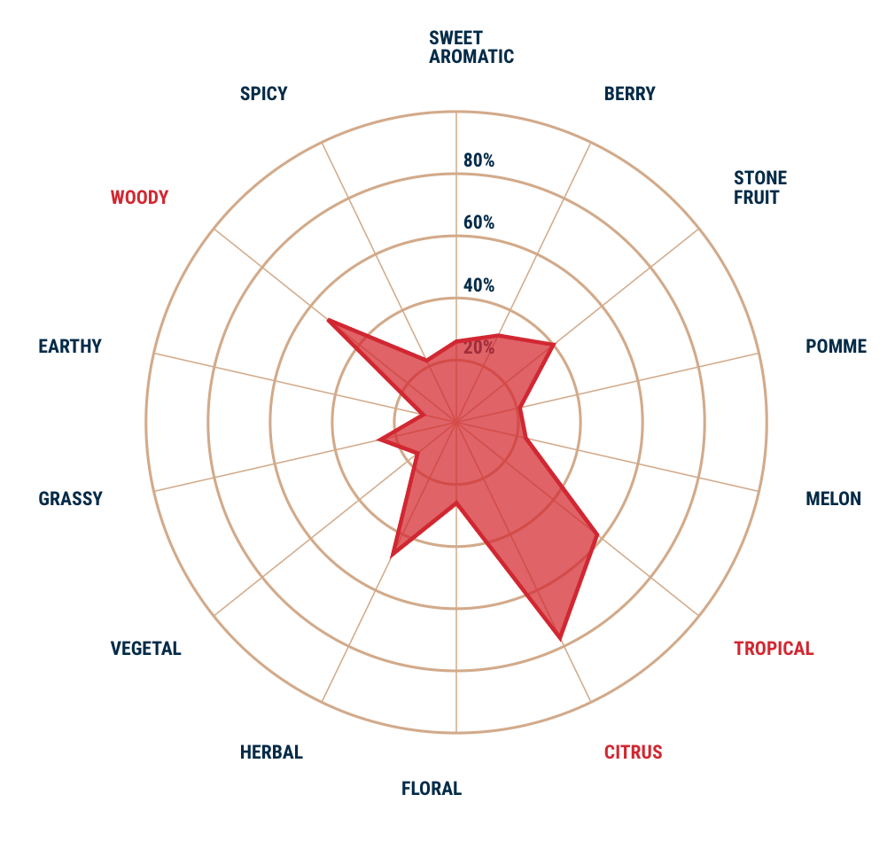
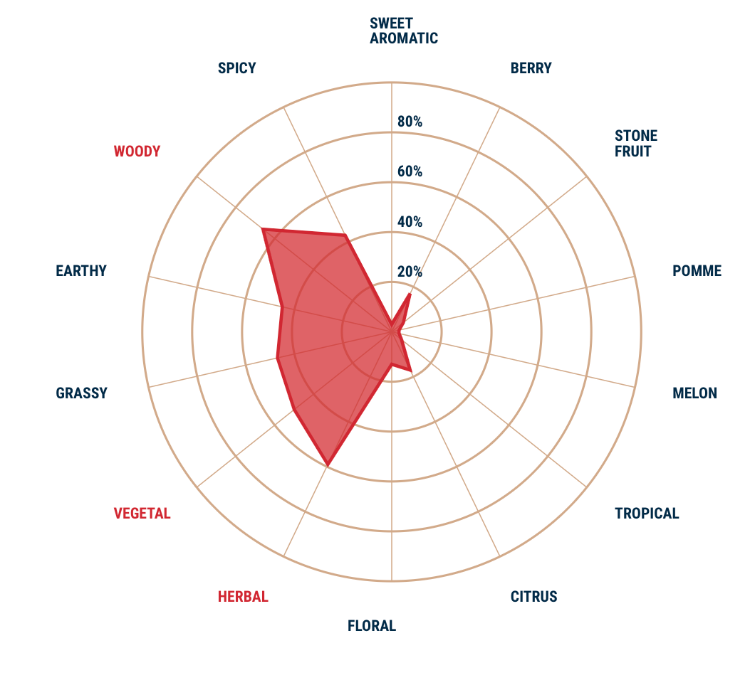
Select hops that will contribute the flavors you seek
Saaz
Cascade
Citra
YakimaChief.com
Notes:
How to set up mash hopping experiment. Here’s how you should go about experimenting. Want to do tropical beer. Here are all the tools.

Slide 27
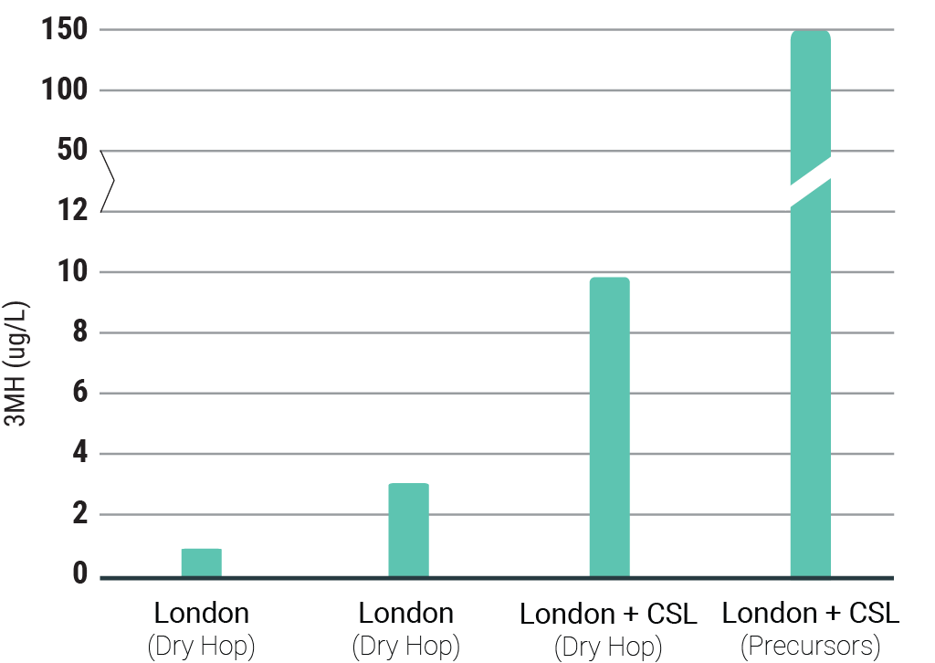
More precursors in wort leads to more thiols in finished beer
3MH in Commercial Beer Samples (Cans)
Second beer is all NZ hops
Precursors are extracted from plants and in liquid form.
Added to fermentor with yeast.

Slide 28
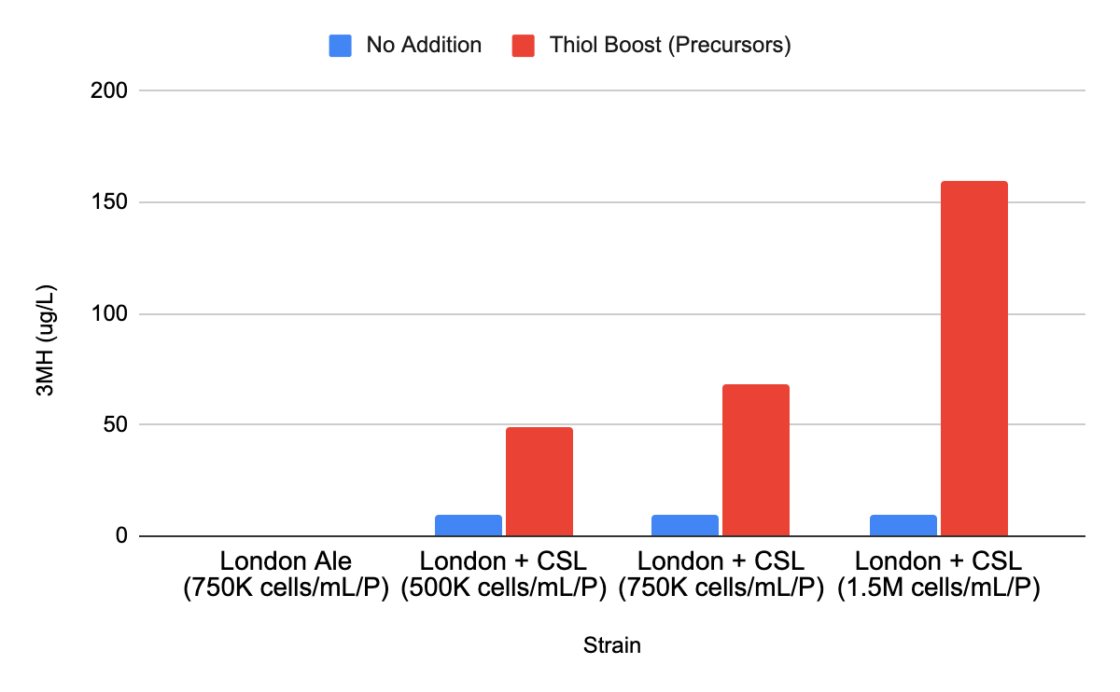
When precursors are added, increasing pitch rate, increases thiol production

Slide 29
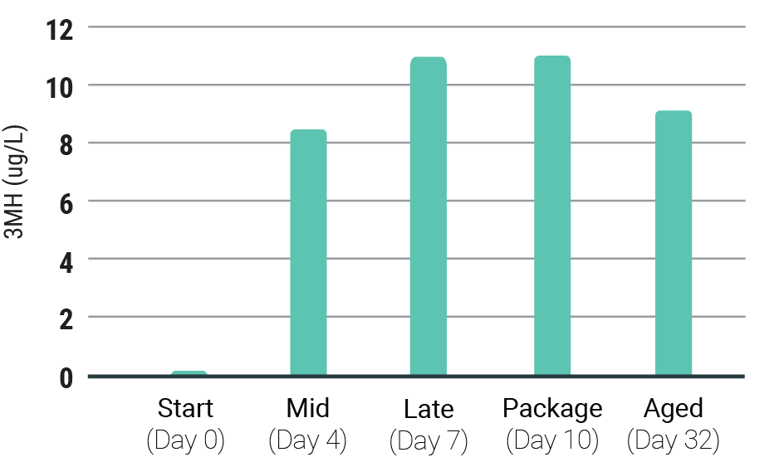
3MH degrades slowly if oxygen is kept low
Tropical flavors associated with 3MH tend to stick around on the shelf.
Oxygen can quickly degrade thiols (data not shown)
Notes:
3MH is stable.

Slide 30
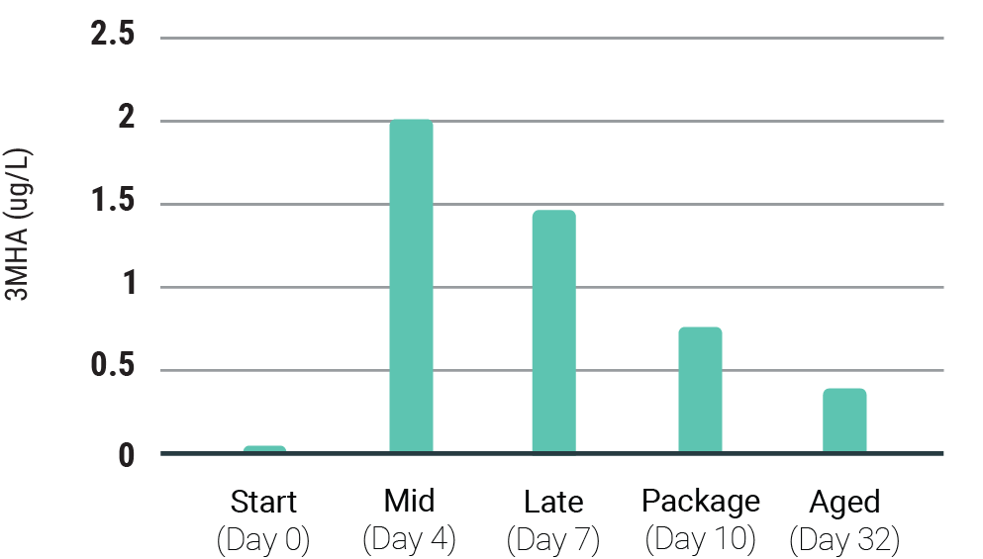
3MHA degrades quickly even when oxygen is low
3MHA has a lower flavor threshold than 3MH, so its disappearance may change the tropical character of the beer.
Unclear is 3MHA is hydrolyzing to form 3MH or if the thiol (sulfur) is reacting with another substrate.

Slide 31
How to Experiment with Thiols at Your Brewery

Slide 32
Experimental Plan for Increasing Thiols
Good experimental design isolates a single variable and utilizes controls. Only change one variable at a time.
Base recipe: Something familiar (eg. flagship IPA recipe).
Beer 1: Remove one hop cultivar from dry hop, and substitute one that is high in free thiols (eg. southern hemisphere hop).
Beer 2: Switch yeast to one that expresses an active CSL. The parental strain should be the same as what is used in the base recipe.
Beer 3: Modify process to increase precursors. Try mash hopping or add pure precursors.
Beer 4: Combine learnings and continue to modify one variable at a time.

Slide 33
Thank you!
Nick Harris
nick@berkeleyyeast.com

